Slide 1

Chapter 2
Network
Models
.

Slide 2
2.1 Protocol Layering
A protocol defines the rules that both the sender and receiver and all intermediate devices need to follow to be able to communicate effectively.
When communication is complex, we need to divide the task between different layers, in which we need a protocol at each layer, or protocol layering.

Slide 3
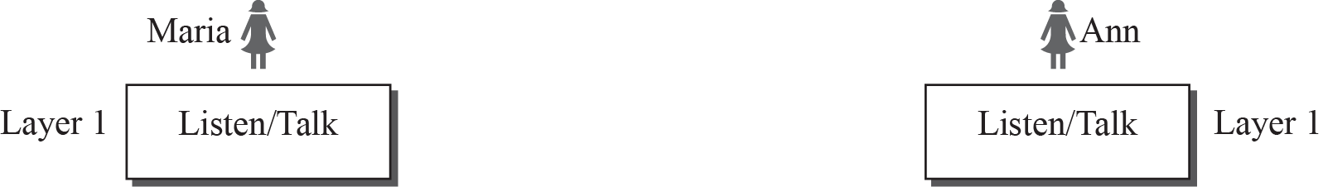
Simple communication
A single-layer protocol
Protocol needed
  Greeting first
  Using proper words based on friendship
  Speaking with courtesy: listen and talk
  Giving chance to other to talk
  Exchanging nice words when they leave

Slide 4







Two-layer model
Logical Connection
Physical Connection

Slide 5
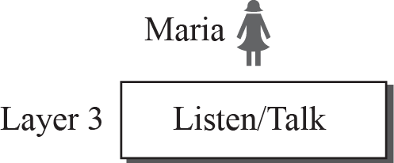
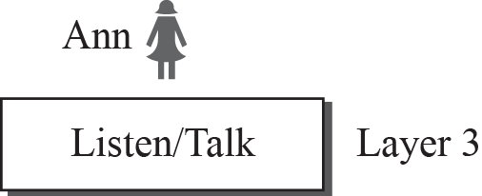
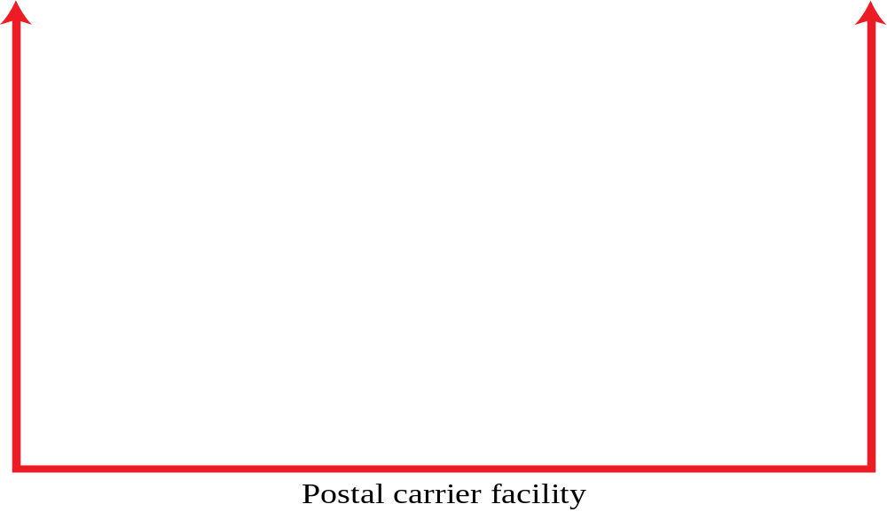


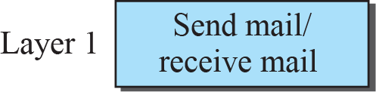
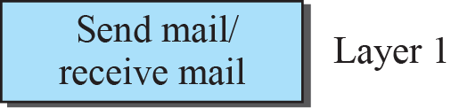
A three-layer protocol
Maria and Ann at different towns talk about business plan after retire. They communicate with regular mails through the post office in a secure way.
1.<number>
Notes:
1.#

Slide 6
Protocol Layering
Divide a complex task into several smaller and simpler tasks
  Each task can be improved independently
  Each layer is a module, which is defined as a black box with inputs and outputs, without concern about how inputs are changed to outputs

Slide 7
Advantages of Protocol Layering
Separate services from the implementation
  We only care if services are the same.
  Improvement on some layers does not need to replace the whole system.
  Buy products made by different companies
  Layering allows different devices to implement some selected layers.
    Different devices may need some communication functions but not all.

Slide 8
Logical connections
Each layer has its layer-to-layer communication or peer to peer communication.
  Maria and Ann can think that there is a logical (imaginary) connection at each layer through which they can send the object created from that layer.

Slide 9
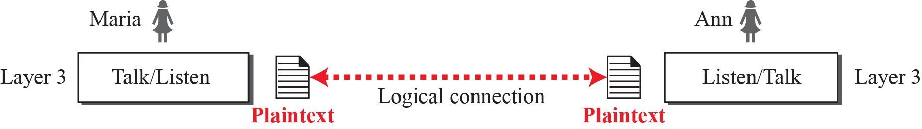
Logical connection between peer layers
1.<number>
Notes:
1.#

Slide 10
Logical connection
Each peer layer communicates with an agreed-upon series of rules and convention called protocols.
The processes on each machine that communicate at a given layer are called peer communication or logical connection.

